Slide 1
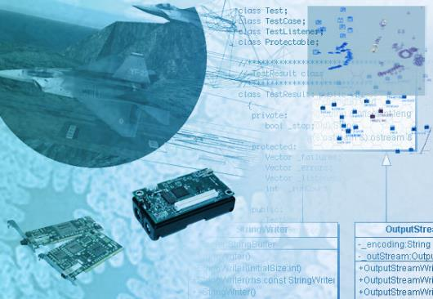
CSYE 6200 Concepts of Object-Oriented Design Session 10
Mark G. Munson

Slide 2
Administration
Mar 29th – Session 10: Communication/Networking
Design Pattern: Abstract Factory
Model-View-Controller
HTTP Networking
Lambdas
Assignment 5b diagram review
Apr 5th – Session 11: Complex Development/Deployment
@Annotations
Libraries and Packages
GUI / GIS Development
Quiz 3
Apr 12th – Session 12: Extra
Assignment $5abc due
Apr 19th – Session 13: Full Review
Apr 26th – Final Exam (Online proctored)

Slide 3
The Lecture
Midterm status
Recap
Lambda
Abstract Factory
Model-View-Controller / Delegates
Networking/HTTP
Assignment 5 Communications

Slide 4
Lambda

Slide 5
Lambda Expressions
public interface MyParamValue {
double getVal(double v);
}
public LambdaTest() {
MyParamValue mpv;
mpv = (n) -> 98.6 * n;
System.out.println(" The Lambda value is: " +
mpv.getVal(2.0));
}

Slide 6
ABstract Factory
Design Pattern

Slide 7
Design Patterns
Creation Patterns
Singleton
Abstract Factory
Behavioral Patterns
Observer
Command

Slide 8
Abstract Factory
Provides an interface for creating related or dependent objects without specifying their concrete classes
Originally designed to select and provide User Interface widgets that belonged to a set (i.e. X/Motif, or OS/2 Presentation Manager (PM))
Commonly used to create instances of services, spawned simulations, and software plugins

Slide 9
Abstract Factory
Factory
Service
{ProductA}
getProduct()
getWorld()
{Abstract Factory}
ProductX
ProductY
{WorldA}
FactoryX
FactoryY
WorldX
WorldY

Slide 10
Model-View-Controller
Design pattern

Slide 11
MVC Operation
Swing Component
View
Controller
Model
MVC is a well known pattern that was originally adopted from Smalltalk
The Model maintains the component state
The View presents the “look and feel” of the component
The Controller manages event handling for the entire component

Slide 12
MVC Operation
Swing Component
View
Delegate
Controller
Model
MVC is a well known pattern that was originally adopted from Smalltalk
The Model maintains the component state
The View presents the “look and feel” of the component
The Controller manages event handling for the entire component

Slide 13
NetWorking

Slide 14
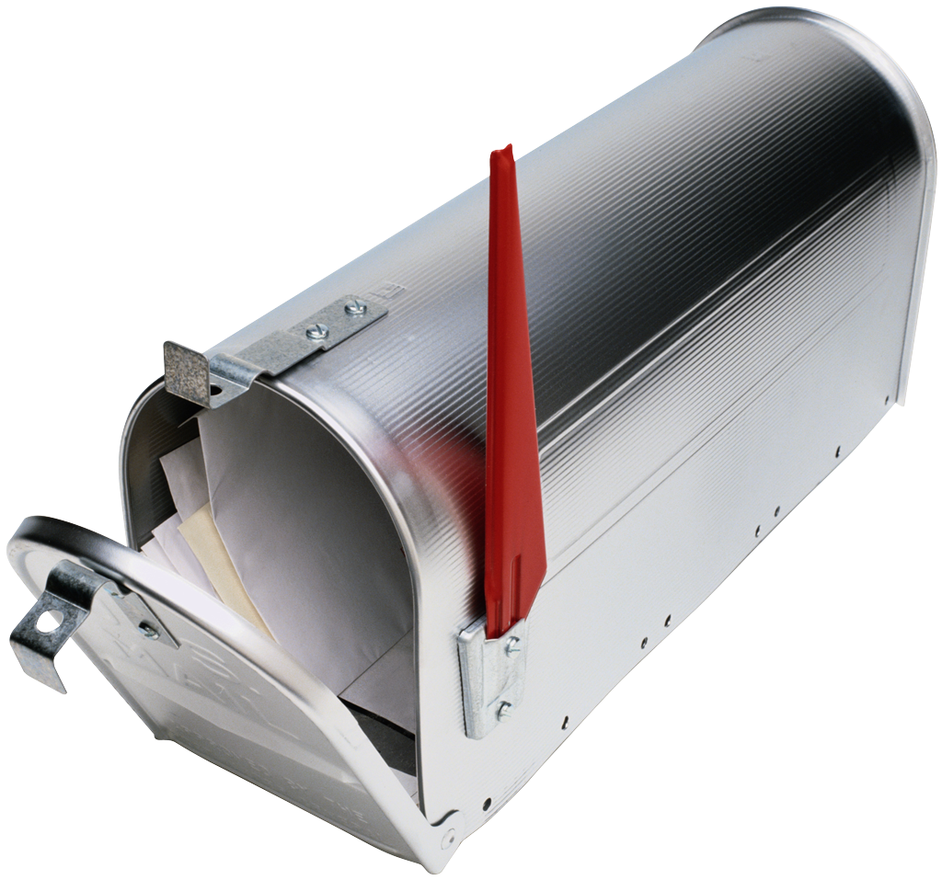
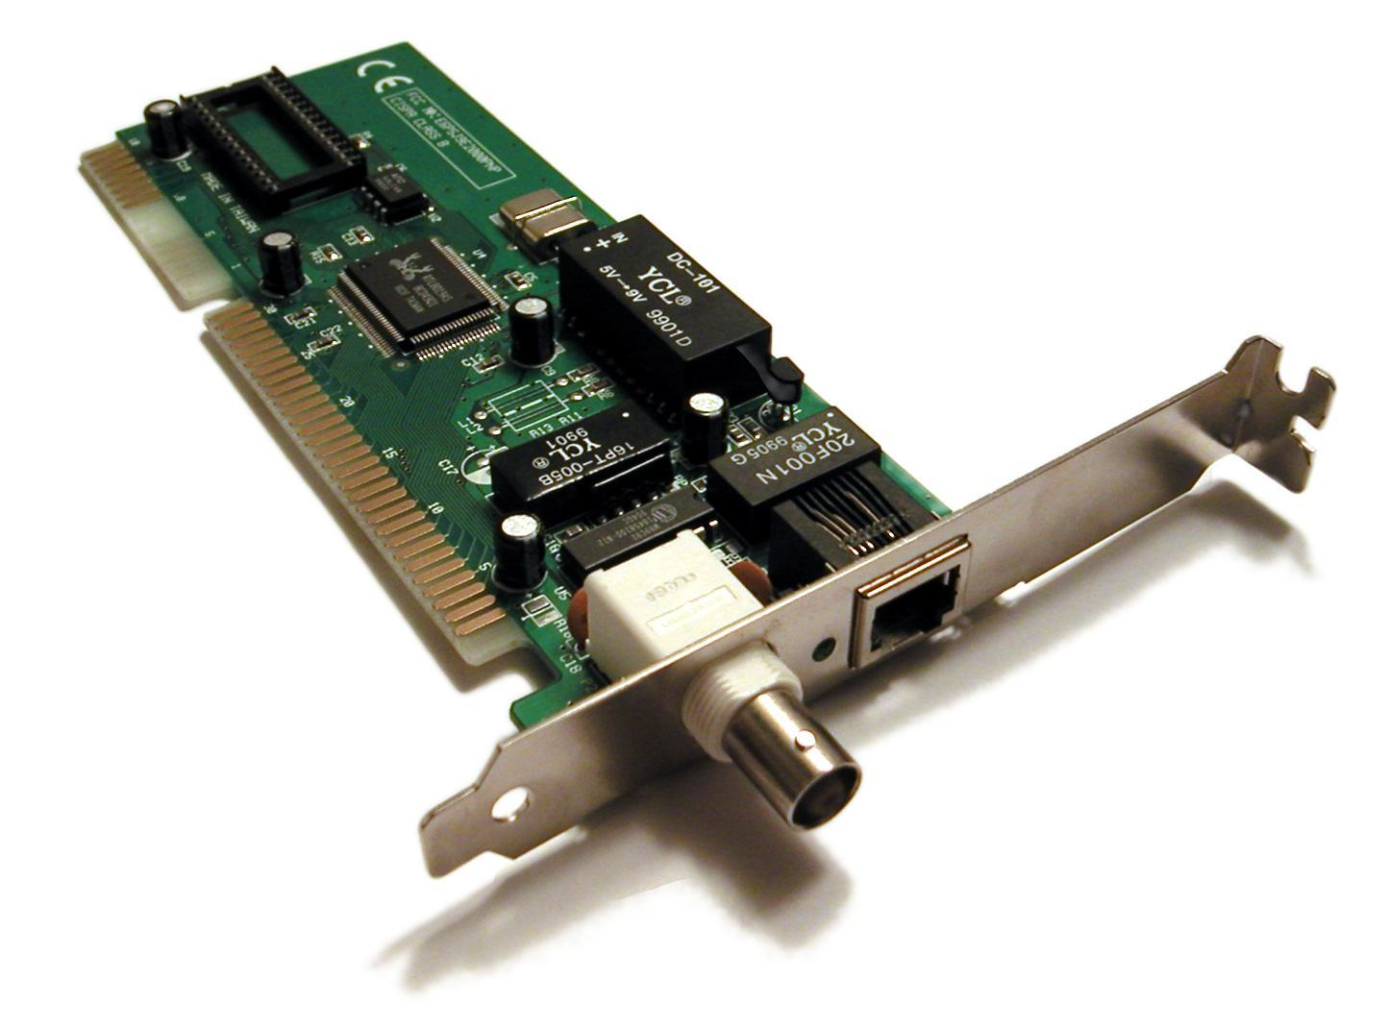
The Protocol Stack
Application (HTTP, FTP, Telnet)
Transport (TCP, UDP, …)
Network (IP, …)
Link (Device driver, …)
Application
Transport
Network
From:
To:
Link

Slide 15
Ports
The Network layer relies on computer addresses, and port numbers to route information across the internet/network
Each application is able to bind a network connection with a port number, which provides an identifying name on the host computer
Postal Addressing
Name
Street Address
Network Addressing
Port (1025)
IP address (129.0.9.1)
Who
Where

Slide 16
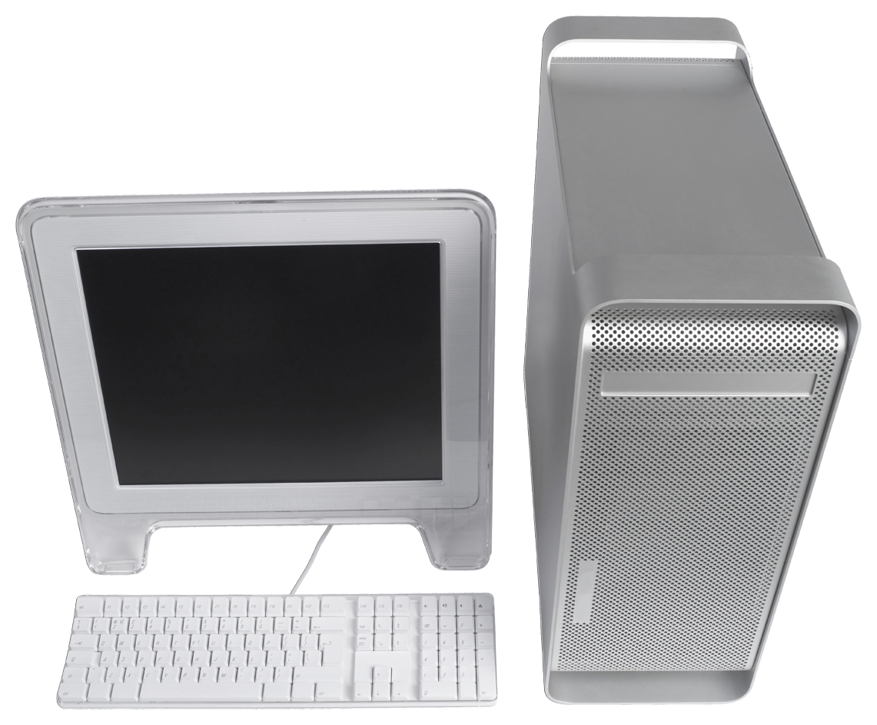

Ports
Ports are bound to an application, so any message sent with the right port number will be received by the associated application.
10.9.132.1
10.9.140.2
OS
Port #
Port #
OS
Browser
1057
WebServer
80
E-mail
3027
POP Server
587
Chat
3040
OpenFire IM
994

Slide 17
Networking Delivery Protocol
Telenet Control Protocol (TCP)
Guaranteed Delivery
Stream Model
URL, URLConnect
Socket, ServerSocket
Web
File Transfers
E-mail
User Datagram Protocol (UDP)
Best effort delivery
Packet model
DatagramSocket, MulticastSocket
Video
Audio
Multi-player Games

Slide 18
Making Connections
Server creates a ServerSocket
it accept connections on a port – and blocks while waiting
Client creates a socket
It attempts to connect to a specified IP address:port
The ServerSocket accepts the connection and binds to a socket pair
The connected socket has an input and output stream

Slide 19
Network Socket
ServerSocket
<<SocketImplFactory>>
accept()
uses
Delegate
Socket Factory
<<SocketOptions>>
uses
creates
creates
Socket
SocketImpl
InputStream
SSLSocket
Datagram SocketImpl
PlainDatagram SocketImpl
OutputStream
Datagram Socket
2
InetAddr

Slide 20
Network Demo
HTTPUrlConnection

Slide 21
BG Review

Slide 22

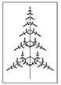
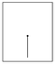
BG Simulation Static Class Diagram
edu.neu.csye6200.ui
{BGApp}
java.util Observable
<<Runnable>>
java.awt
JPanel
java.util
<<Observer>>
NameApp
BGSimulation
BGPanel
JButton
BGGeneration
<<BGRule>>
JTextField
A BGGeneration should hold a full tree/leaf
A BGRule should process input generations and produce an output generation
BGStem

Slide 23
Next Week
JABG:
Annotations: pp. 446-448
Quiz 3 next week
GUI / GIS Development
Apr. 12th – Assign 5abc due
Abstract class provided in a BGApp.zip file
Submission/Task checklist

